Slide 1
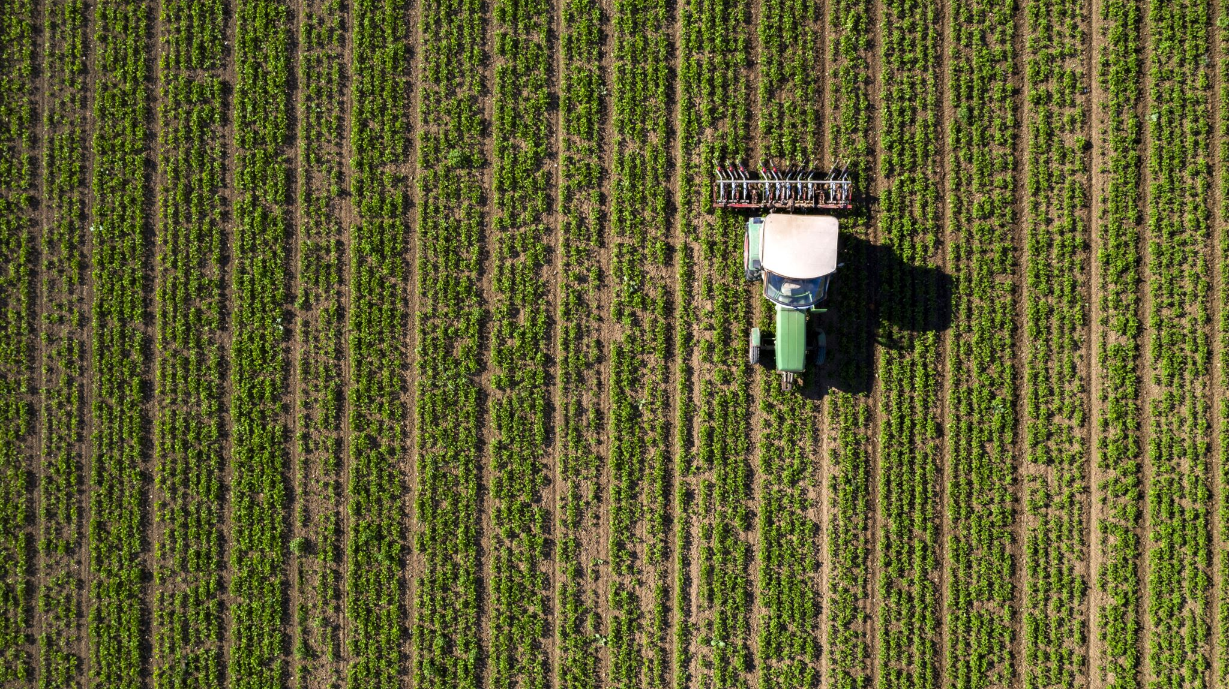
Crop Planting Calender Generator
Presented by Sibongile Mthombeni
Agritech

Slide 2
Outline
Introduction
Problem statement
Aim
Proposed solution
How it works

Slide 3
Introduction
Farmers often face challenges in choosing the correct planting time due to unpredictable weather and seasonal changes. The crop planting calendar generator helps farmers to determine the best planting and harvesting Periods based on crop type and location leading to Improve yield and reduced financial losses.

Slide 4
Problem statement
Many farmers struggle to know the correct planting time
Climate change has made seasons unpredictable
Planting at the wrong time leads to :
Low yield
Financial losses
Crop failure

Slide 5
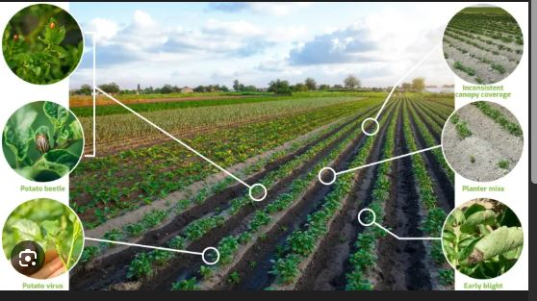
Aim
To develop a website that helps farmers to determine the best planting and harvesting time based on location and season
To improve crop productivity

Slide 6
Proposed solution
It is a rule-based logic that generates planting schedules
Allows farmers to select crop type and region
Generates recommended planting and harvesting dates

Slide 7

How it works
The user selects the location and crop type
The system uses seasonal rules based on location and crop type
The system applies seasonal and region-based rule from the selected crop
Results are displayed to the user

Slide 8
Target users
Small-scale farmers
Emerging and commercial farmers
Agricultural extension officers
Farming cooperates and NGOs

Slide 9
Conclusion
The Crop Planting Calendar Generator helps farmers choose the right planting time based on seasonal and regional conditions. It reduces the risk of crop failure, supports better planning, and improves productivity. This project shows how technology can support smarter and more sustainable farming decisions

Slide 10

Thank you

